Slide 1

Milestone 1
RIOT-Tutorial SAUL Registry CoAP Further Project

Slide 2
RIOT-Tutorial
First time made tutorial with computer in Lab (no real starting difficults)
So I tryed getting RIOT work on my own computer
I work with Ubuntu 18.04.3 LTS on a virtual maschine (VirtualBox)
Installed everything that was mentioned on the first tutorial page
Quick Setup and Regular Setup
Dont know on what it is running now
Had lot of problems getting RIOT running on my computer
After it worked I repeated some tutorials

Slide 3
Saul-Registry
Easy to use shell
Got very fast first reading from sensors and set actors
Tryed to find out how saul works.
Main.c is empty had no clue were to find information
After long search asked others, they showed me where the shell functions are:
sys/shell/commands/sc_saul_reg.c
Copied functions from „sc_saul_reg.c“
Changed shell functions to normal calling functions to use them with CoAP

Slide 4
CoAP
Did the example tested it with a partner worked well
Started working on saul + gcoap
First test with only one LED worked good
Had truble getting the „payload“ written probebly
Wanted to innteract with all sensors
Implemented a version at home
Have to be checked if it works (compiled and loaded on board)

Slide 5
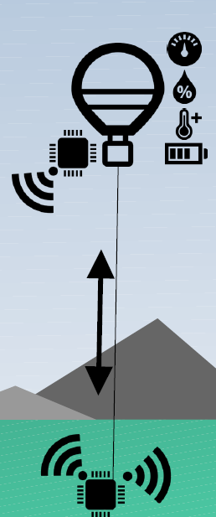
Further Project
Plan:
Working with a display over SPI
Showing the ballons data at the base station
Maybe showing pictures from the ballon
Maybe be able to change settings with Buttons/Touch of the ballon
Let a human interact from Basestation with one/Multiply ballons
Works like a telephone box but for messages.
„We need help“
„We´re fine“
…
Temp: -3°C
Hum: 34%
Batt: 59%

Slide 6
Questions ?

